Slide 1

FLIGHT PRICE PREDICTION MODEL
SEEP BANSAL

Slide 2
INTRODUCTION
Nowadays, flights are considered as the major source of transportation i.e people do travel frequently via air. Flight price is something which is very hard to guess.
The various airline companies use complex algorithms to predict the price of the flight. These companies have their own factors to decide the fares.
The price of the flights increases or decreases unexpectedly. This usually happens as these airline companies wants to generate maximum revenue

Slide 3
PROJECT SUMMARY
Determining the price of the flight is one of the toughest things to predict as we may see a price today and again check out the price of the same flight tomorrow and it will be a different story.
In order to understand this problem, we will try to take the help of some machine learning algorithms. The various information regarding the flights like source, destination, number of stops, duration, arrival time and departure time is collected to predict the fluctuating fares.
Various machine learning algorithms like Linear Regression, Support Vector Mechanism, Decision Tree Regressor, Random Forest Regressors, K Neighbours Regressor are implemented and evaluated to predict the price of the car across different cities in India.
The best results are given by Random Forest Regressor. Though conventional Linear Regression also gave the good results with the advantage of significantly lower training time as compared to the aforementioned algorithm.

Slide 4
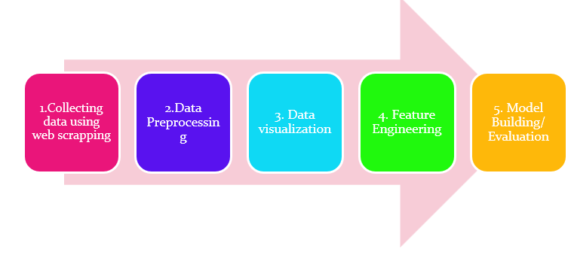

Slide 5
DATASET
The dataset used in this model is the data collected from the most leading websites like www.yatra.com and www.makemytrip.com.
The dataset contains around 1600 rows and 9 features were extracted from the site.
The data collected is of domestic flights.
The various web scrapping tools like selenium and beautiful soup were used.
Features like Source, Destination, name of the airlines, Arrivals, Departures, number of stops and price were scrapped.
As we are supposed to predict the price of the flight so price will be the output variable all other features are the input variable.

Slide 6
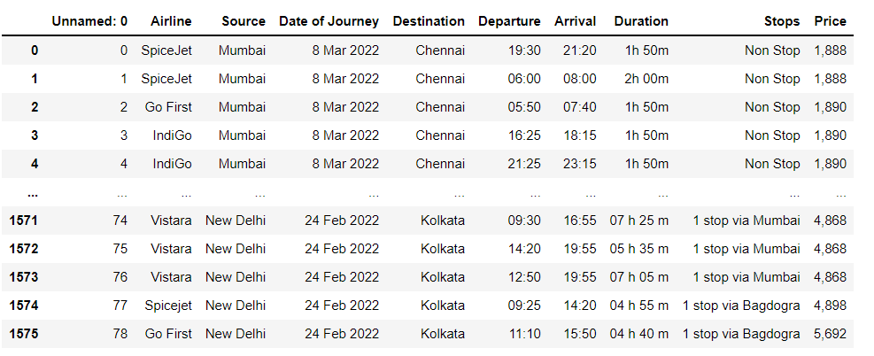
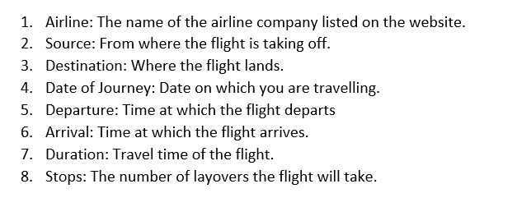

Slide 7
DATA PREPROCESSING/DATA CLEANING
Preprocessing is one of the important steps in building a model.
In this phase we usually deal with missing values if any or if there are any unrealistic values. In case of any irrelevant value, we will remove that data.
In case if the data loss is huge then removing/dropping of data is not a good practice.
We will try to improve the quality of data in this phase so that we can develop a model with high accuracy score.
For the dataset, we will first of all fill the missing values if any, then we have most of the data in categorial form we will convert the data in numerical form so that we are able to fed the data into classification algorithms.
We can also check if there exist any multicollinearities through VIF FACTOR calculation.

Slide 8
EDA CONCLUDING REMARKS
Typecasting of the various columns is done i.e datatypes of the columns were changed.
New columns were created from the existing columns.
Null values are removed.
Label Encoding is done as there were many categorical values that were converted to numeric values.
Skewness was removed.
Scaling is done to bring all the variables on same scale.
VIF factor is calculated to check the multicollinearities

Slide 9
VISUALIZATIONS

Slide 10
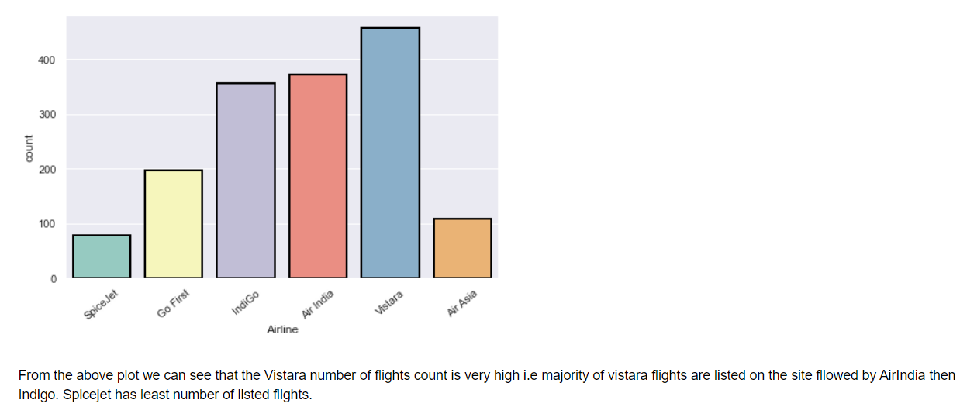
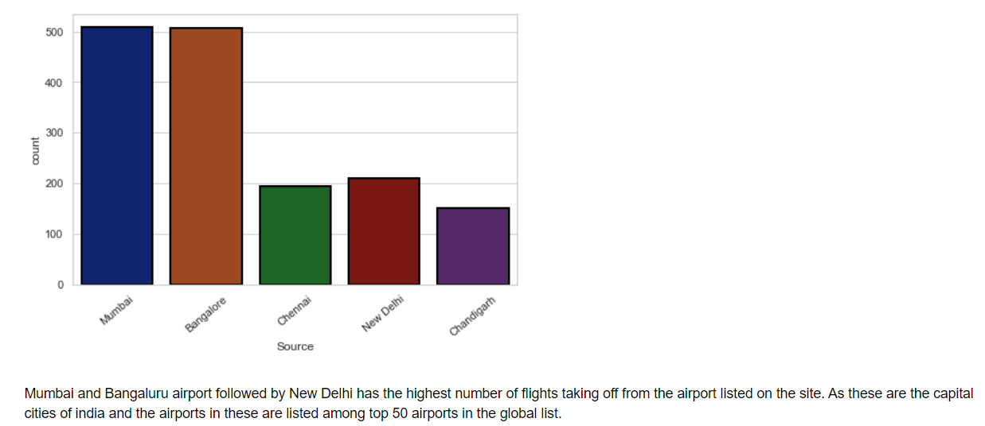

Slide 11
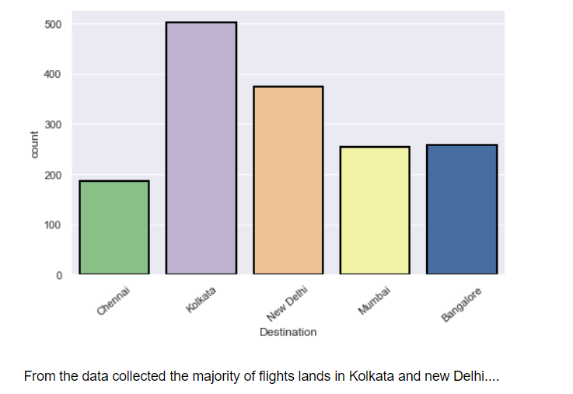
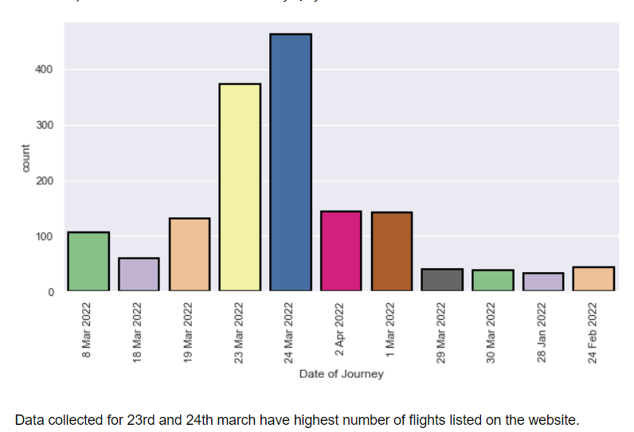

Slide 12
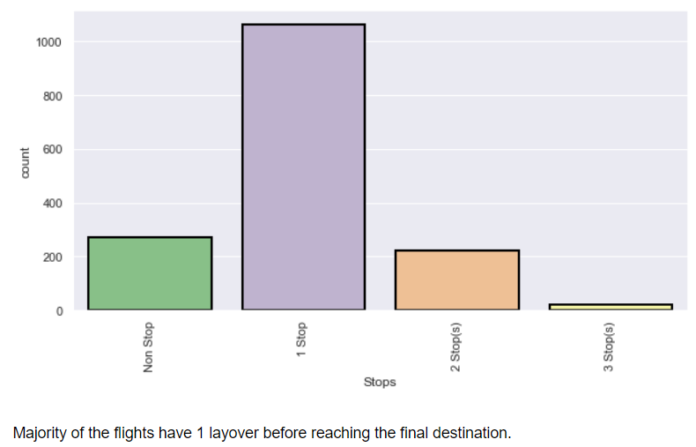
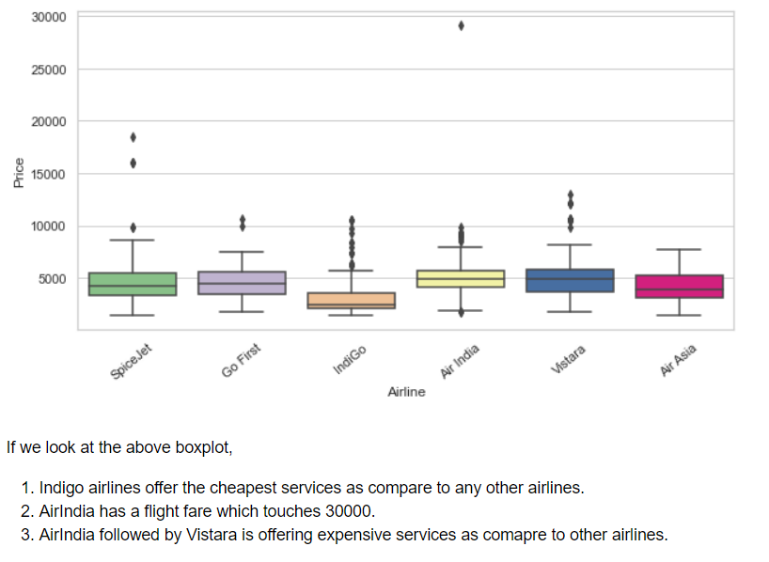

Slide 13
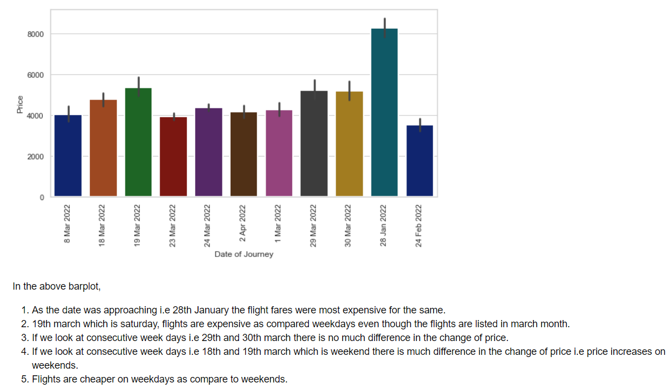
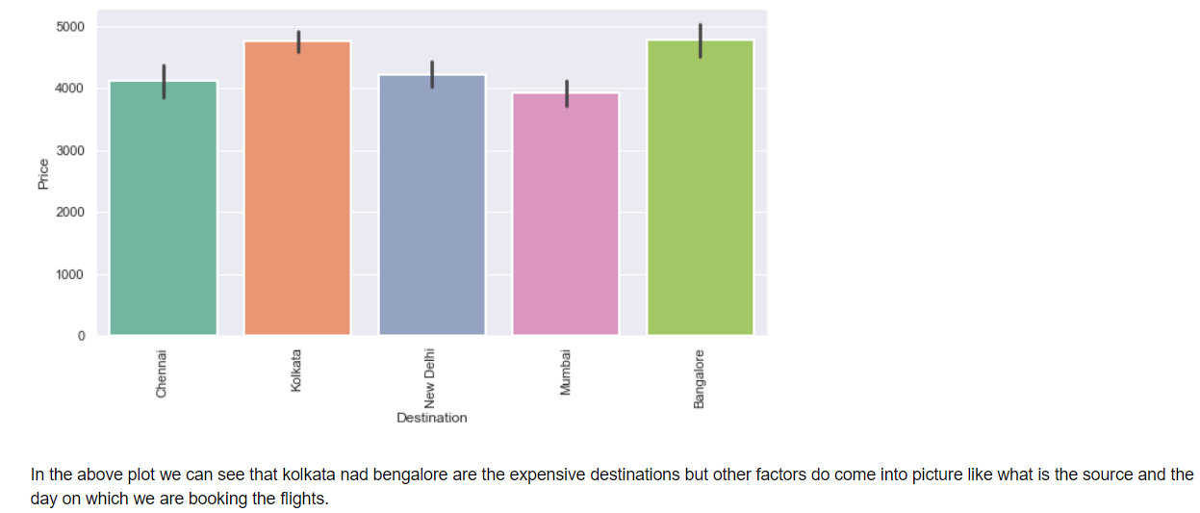

Slide 14
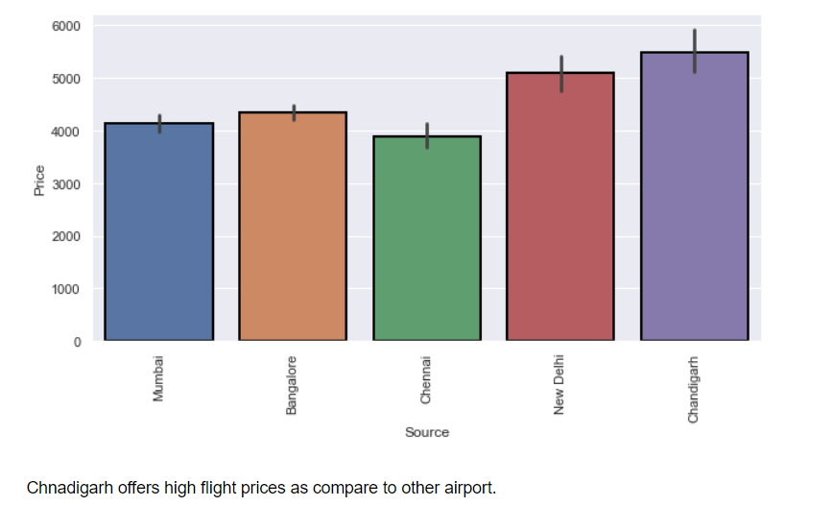
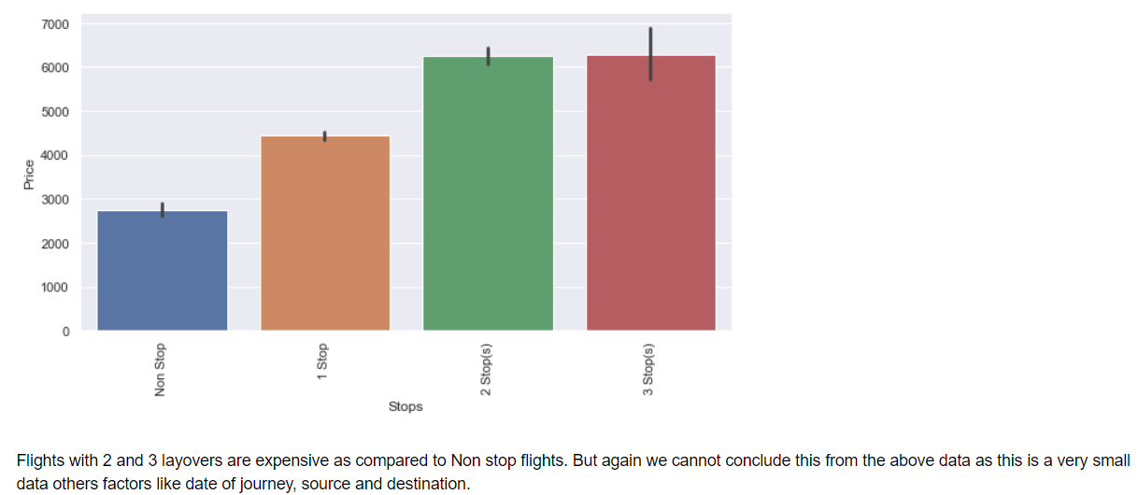

Slide 15
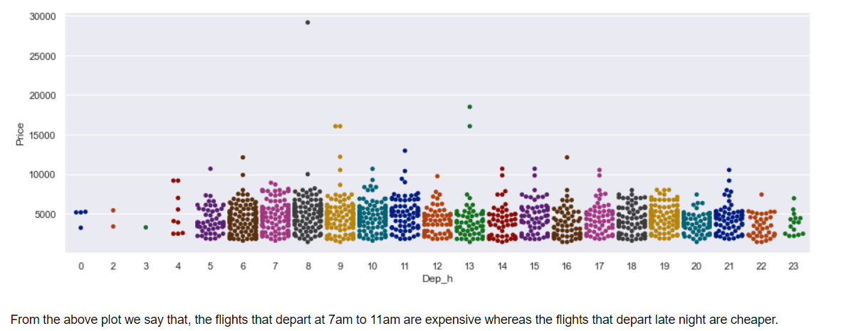
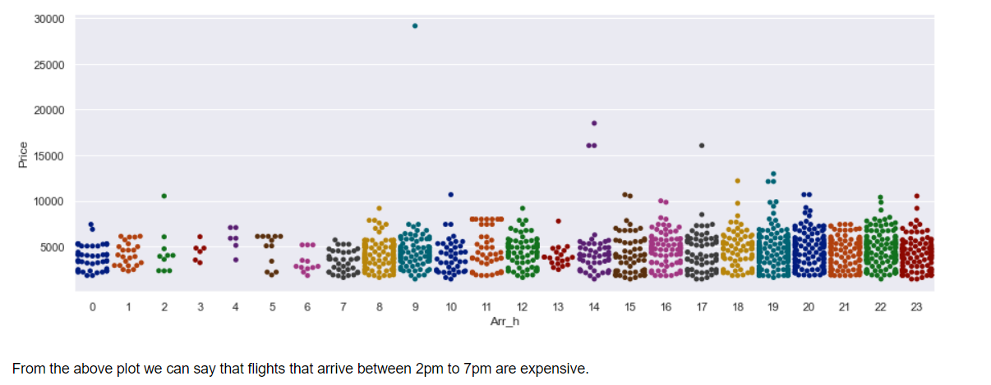

Slide 16
ALGORITHM USED
Linear Regression Model
Decision Tree Regressor
Random Tree Forest Regressor
K Neighbors Regressor
Support Vector Regressor

Slide 17
REGRESSION MODEL
Evaluation of model plays a very important role in evaluating the performance of any Regression. The metrices that are evaluated here are the R2 score, MSE, MAE, RMSE.Time taken to test the model on dataset plays a very crucial role.
Here, for Random Tree Forest Regressor the accuracy score we are getting is 99% and the MSE is around 2618141.9 , MAE is 691.06 and RMSE is 1618.06 which is least in any of the model build and the computational time is very less.

Slide 18
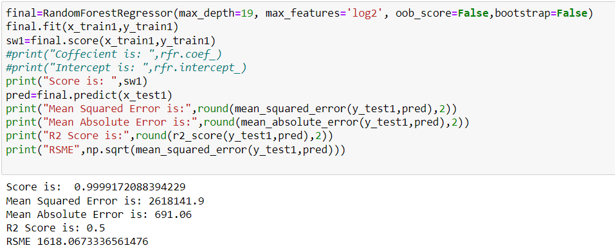

Slide 19
CONCLUSION LIMITATIONS AND SCOPE
Though it is very tough to understand the price fluctuations of the flight fares, by developing this model and performing different algorithms was aimed to get the different perspectives. The various data visualization techniques were used. Data was analyzed from different point of views many preprocessing techniques like scaling, label encoding etc were followed. The relation between different features were examined and the best model Random Forest Regressor with the best results were used to predict the best fares.
The above model is used to predict the fares of the flights. However, this was relatively a small dataset with around 1600 rows was used make a strong inference and the data was collected form only 2 site.
Gathering more data from different sites or form the same site could lead to more better results. Collecting more features like whether meals are included or not, insurance is inclusive or not could actually help is in building a robust model.
Another room of improvement is more data preprocessing and more data cleaning techniques to be followed which could help is reducing RMSE. We could actually build this model with different scaling technique like min-max scaler which may give us better results or we could also try different encoding technique which may enhance the results.

